Slide 1
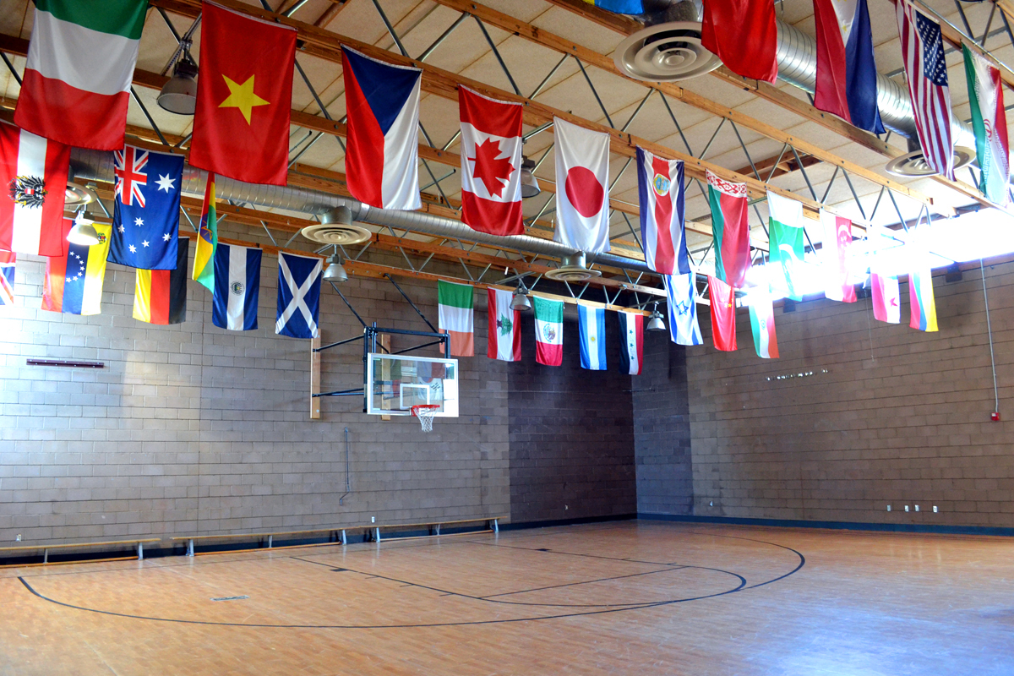
KMDL Keystone Montessori DISTANCE LEARNING ELEMENTARY program

Slide 2
Keystone Montessori Distance Learning Plan of Action
Keystone has created a program for implementing distance learning based on the structure of our normal school day as a means for continuing your child’s education while at home. Our goal is to provide an authentic Montessori experience while we adjust to this “new normal”. The Keystone Montessori Distance Learning plan (KMDL) will continue in conjunction with on-campus instruction once school physically reopens. This will include lessons, check-ins, gatherings, Specials (Art, Spanish, Music, & Yoga), Great Work, small group work, mindfulness, and physical education. Utilizing the Google Classroom and Zoom platforms for communication and one-on-one meetings, your child will have guidance in purposeful and focused work.
Notes:
Program intro and “conventional” comparison - Lauren

Slide 3
KMDL Components
Maintain a structured daily schedule
Present new academic content through virtual lessons
Provide virtual and physical materials (when possible) to aid at-home learning
Detail clear expectations of students
Expect consistent student accountability
Allow flexibility regarding screen time based on individual family needs
Ensure that students are progressing through the curriculum
Regular office hours for students and parents
Notes:
Materials / Crates

Slide 4
Zoom
Our daily schedule will engage your child in a full day of activity with breaks for snack, lunch, and recess. Students should be prepared for a full school day (8:15am – 2:45pm). Using Zoom, we will facilitate the following:
Group Gatherings Read Aloud
Small Group Lessons Physical Education
Small Group Breakouts Check-In Meetings
Art, Spanish, Yoga & Music Specials Special Education
Notes:
Elementary children are intensely social

Slide 5
Google Classroom
The children will be able to share their daily work and access additional resources and information. This will enable the guides to be able to evaluate work-in-progress and completed projects as they would in the physical classroom.

Slide 6
KMDL Student Expectations
Students will be signed into Zoom for daily events to maintain full participation. When operating remotely, we depend upon video conferencing for our observations, to ensure student accountability and to maintain close contact with the students.

Slide 7
KMDL Student Expectations
Be ready to start the school day on time (8:15 am)
Keep supplies organized and prepared for use throughout the day
Attend all scheduled activities
Communicate with the guide
Participate in lessons
Complete follow up work on a regular basis
Turn in any assigned work on time
Initiate research and independent study
Present and/or submit completed work
Seek further support when needed

Slide 8
How Can Parents Support KMDL at Home?
Maintain a consistent before/after-school routine
Provide a designated and appropriate work space for your child’s school day
Ensure your student logs into her/his device at the scheduled time
Help your child have supplies and materials ready for their day
Stay in communication with your student’s guide and make contact during designated office hours
Provide your observations to the guide
Allow your child to work independently

Slide 9
Accountability
As we move into the new school year, expectations for students will increase to ensure they are progressing and making their way through the Montessori Elementary program. KMDL means to keep accountability between your child and her/his guide as much as possible. Students are only able to develop their independence when allowed to make autonomous choices. A certain amount of freedom to experiment, explore, and even to make mistakes is absolutely critical to maintain intrinsic motivation.
Our primary tool for accountability of regular check-in meetings will be maintained between the guide and the student; however, any observations parents supply are welcomed.

Slide 10
Physical Resources
In addition to the online resources provided by Keystone, we will also be providing each child with the following materials to ensure they are successful with KMDL. This will include, but is not limited to:
Supply pouch Sharpener
Pencils Math book
Eraser Language book
Glue stick Journal writing book
Scissors Completed work folder
Small ruler Work-in-progress folder
Colored pencils Compass
Scrap paper
*Students may choose their own record books and sketchbooks for Art

Slide 11
Access to Montessori Materials
Students will have the ability to work with Montessori Materials at home. Physical materials will be provided by Keystone as needed for specific lessons and will be available for pick up at the school at an arranged time. Virtual materials will be available online.

Slide 12
Kmdl schedule
LOWER ELEMENTARY
Monday – Whole Class Meeting
Monday – Friday
8:15 am – 11:30 am – lessons
11:30 am – 12:30 pm – lunch break
12:30 pm – 2:45 pm – lessons/specials (Spanish, Art, Music & Yoga)/individual and small group meetings

Slide 13
UPPER ELEMENTARY
Monday – Whole Class Meeting
Monday – Friday
8:15 am – 12:00 pm – lessons
12:00 pm – 1:00 pm – lunch break
1:00 pm – 2:45 pm – lessons/specials (Spanish, Art, Music & Yoga)/individual and small group meetings

