Slide 1
Title IX Staff Training: What Is It and How Do I Report It?
Keystone Montessori
August 19, 2022
Presented by: Lawton L. Jackson, Esq.

Slide 2
How Does a Law Come to Be?

Slide 3
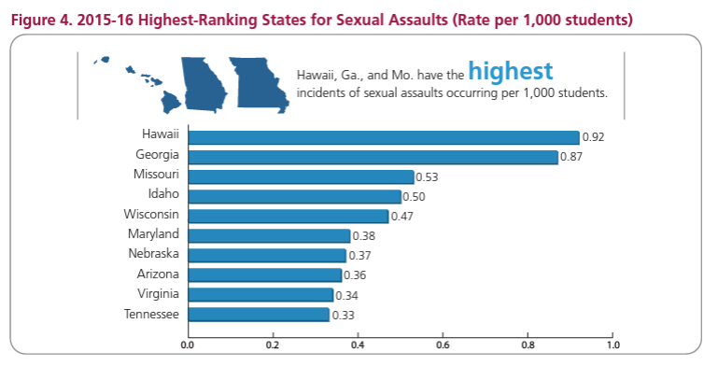
How Does a Law Come to Be?

Slide 4
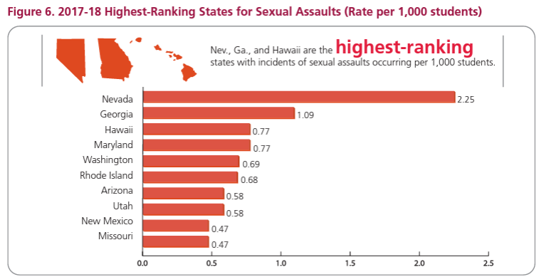
How Does a Law Come to Be?

Slide 5
How Does a Law Come to Be?

Slide 6
How Does a Law Come to Be?

Slide 7
What Are We Doing Here Today?
Define Title IX
Recognize an allegation that falls under Title IX (Actual Knowledge)
Understand Reporting Obligations
Learn where to report potential Title IX matters
Overview of Grievance Procedures

Slide 8
What is Title IX About?

Slide 9
Scope of Title IX for Schools
Prohibits discrimination and harassment based on sex in education programs and activities at schools that receive federal funding.
No person in the United States shall, on the basis of sex, be excluded from participation in, be denied the benefits of, or be subjected to discrimination under any education program or activity receiving Federal financial assistance.

Slide 10
Scope of Title IX for Schools
If any part of a K-12 school or college receives federal funding for any purpose, then all operations of the school or college are covered by Title IX
Protects students, employees, applicants for employment, students who are applying to the school and any other person who may participate in the School’s activities and/or programs
Includes sexual harassment prohibitions for employees and students as well

Slide 11
Definition: Sexual Harassment
Conduct on the basis of sex that meets one or more of the following:
A District employee conditions the provision of an aid, benefit, or service of the District on an individual’s participation in unwelcome sexual conduct;

Slide 12
Definition of Sexual Harassment
Unwelcome sexual conduct that a reasonable person would find to be so severe, pervasive, and objectively offensive that it “effectively denies a person equal access” to the District’s education program or activity;
Sexual assault, dating violence, domestic violence, or stalking.

Slide 13
Sexual Assault
An offense classified as a forcible or nonforcible sex offense under the uniform crime reporting system of the Federal Bureau of Investigation.
20 U.S.C. 1092(f)(6)(A)(v)
Any sexual act directed against another person, without the consent of the victim including instances where the victim is incapable of giving consent
Including “forcible fondling” – touching of the private body parts of another person for the purpose of sexual gratification

Slide 14
Stalking
Engaging in a course of conduct directed at a specific person that would cause a reasonable person to:
Fear for his or her safety or the safety of others; or
Suffer substantial emotional distress
34 U.S.C. 12291(a)(30)

Slide 15
Dating Violence
Violence committee by a person who is or has been in a social relationship of a romantic or intimate nature with the victim and where the existence of such a relationship shall be determined based on a consideration of the following factors:
the length of the relationship;
the type of relationship;
the frequency of interaction between the persons involved in the relationship
34 U.S.C. 12291(a)(10)

Slide 16
Domestic Violence
Felony or misdemeanor crimes of violence committed by a current or former spouse or intimate partner of the victim, by a person with whom the victim shares a child in common, by a person who is cohabitating with or has cohabitated with the victim as a spouse or intimate partner, by a person similarly situated to a spouse of the victim under the domestic or family violence laws of the jurisdiction receiving grant monies, or by any other person against an adult or youth victim who is protected from that person’s acts under the domestic or family violence laws of the jurisdiction.
34 U.S.C. 12291(a)(8)

Slide 17
Examples of Sexual Harassment
Suggestive or obscene letters, notes, derogatory comments, slurs, jokes
Display of sexually suggestive objects, pictures, or cartoons
Assault, touching, impeding or blocking movement
Leering or other conduct that is physically threatening, harmful or humiliating
Continuing to express sexual interest after being informed that the interest is unwelcome
Includes harassment based on gender identity or expression

Slide 18
Gender Identity and Expression Bostock v. Clayton County
Title VII of the Civil Rights Act of 1964
SCOTUS concluded that discrimination based on sexual orientation and gender identity inherently involve treating individuals differently because of their sex.
It reached this conclusion in the context of Title VII of the Civil Rights Act of 1964 which prohibits sex discrimination in employment.

Slide 19
Gender Identity and Expression Bostock v. Clayton County
Courts rely on interpretations of Title VII to inform interpretations of Title IX.
The USDOE issues this Notice of Interpretation to make clear that it interprets Title IX’s prohibition on sex discrimination to encompass discrimination based on sexual orientation and gender identity

Slide 20
Gender Identity and Expression Bostock v. Clayton County
Numerous Federal courts have relied on Bostock to recognize that Title IX’s prohibition on sex discrimination encompasses discrimination based on sexual orientation and gender identity
A school’s policy or actions that treat gay, lesbian, or transgender students differently from other students may cause harm

Slide 21
Office for Civil Rights (OCR)
OCR will fully enforce Title IX to prohibit discrimination based on sexual orientation and gender identity in education programs and activities that receive Federal financial assistance from the USDOE.

Slide 22
Implementing OCR’s Interpretation
Any complaint alleging discrimination based on sexual orientation or gender identity also must meet jurisdictional requirements as defined in Title IX and the USDOE’s Title IX regulations, other applicable legal requirements, as well as the standards set forth in OCR’s Case Processing Manual, www.ed.gov/ocr/docs/ocrcpm.pdf.

Slide 23
Definition: Sexual Harassment
Prong 2: Conduct on the basis of sex if so severe, pervasive, and objectively offensive that it effectively denies a person equal access to the recipient’s education program or activity
OCR interprets Title IX to include harassment on the basis of a person’s transgender status or homosexuality

Slide 24
Definition: Sexual Harassment under Bostock Interpretation
“On the basis of sex” includes: Unwelcome conduct on the basis of transgender status or homosexuality may, if so severe, pervasive, and objectively offensive that it effectively denies a person equal access to the recipient’s education program or activity on the basis of their transgender status or homosexuality, constitute sexual harassment prohibited by Title IX. 34 C.F.R. § 106.30(a).

Slide 25
District Liability for Sexual Harassment
The District will violate Title IX where it has actual knowledge of an allegation of sexual harassment experienced by an individual in the educational program/activity and the District acts with deliberate indifference to that notice.

Slide 26
What is Actual Knowledge of Harassment?
A report to ANY elementary or secondary school employee
ALL employees must be trained to immediately communicate any report of conduct that would meet the definition of harassment to the Title IX Coordinator
A report to the Title IX Coordinator made at any time via any method of communication
A report made to any District official who has authority to institute corrective measures

Slide 27
Is There Actual Knowledge?
Sally reports to her paraprofessional that Jeff keeps trying to grab her breasts and butt
Johnny reports to his teacher that almost everyday, during online classes, Jennifer uses a homophobic slur toward him in the chat function
Jessica reports to the bus driver on her way home one day that Stephanie had photoshopped Jessica’s head on a nude photo and sent it to the entire 7th grade class
Notes:
ALL ARE YES

Slide 28
Actual Knowledge?
David tells his best friend that a coach makes him very uncomfortable because one evening after a training session, the coach got into the shower at the same time David was showering and has, several times since then, rubbed David’s shoulders and brushed up against him in a way that David finds creepy. David is really upset now because this coach told him privately that he would like to make David team captain next year, but David is going to need to do “something” for him.
Notes:
NO, because David never tells any school employee

Slide 29
Actual Knowledge?
Parent of Jamie tells her neighbor, who works in the cafeteria at the middle school, that she saw messages from a boy on her daughter’s phone that included a demand for a nude photo and threat to tell everyone on social media that she is a whore if she doesn’t send him the picture. Parent tells her neighbor that she blocked the student’s number but isn’t planning to alert the school.
Notes:
YES – neighbor works art the school. Neighbor must report to Title IX Coord at earliest convenience

Slide 30
District OBLIGATIONS UNDER TITLE IX

Slide 31
What Affirmative Steps Does Title IX Require?
Employ a Title IX Coordinator
Have and disseminate a policy and grievance process to address sex discrimination, including sexual harassment
Post on the District’s website:
Nondiscrimination Notice
The contact information for the Title IX Coordinator
The training materials for the investigators and decision makers
The grievance process

Slide 32
reports of sexual harassment & the grievance process

Slide 33
How is it Reported to Staff?
Reports can be made by anyone and by mail, telephone, email to Title IX Coordinator or by any means that results in the Title IX Coordinator receiving the report
Any report triggers District responsibilities – Important to send notice of any report to Title IX Coordinator
Do not make a judgment as to whether the report is sexual harassment – that is the Title IX Coordinator’s job in responding

Slide 34
How Should Staff Elevate?
Any report to staff triggers District responsibilities – Important to send notice of any report to Title IX Coordinator
Any employee with actual knowledge of an incident or allegation of sexual harassment must report to their principal/lead administrator as soon as practicable
Do not bypass campus leadership
Do not make a judgment as to whether the report is sexual harassment – that is the Title IX Coordinator’s job in responding

Slide 35
How Should Staff Elevate?
As soon as Administrators/Principals are made aware of a potential Title IX matter, contact District Title IX Coordinator
Do not investigate
Do not discipline
Do not make a judgment as to whether the report is sexual harassment – that is the Title IX Coordinator’s job in responding
Prepare to remain engaged in potential Title IX matter

Slide 36
Your Title IX Coordinator
Stefan Linder, Associate Head of School
1025 E. Liberty Lane
Phoenix, AZ 85048
stefan@keystonemontessori.com
Telephone: 480-460-7312

Slide 37
Administrator Role in Title IX Process
Coordinator will discuss next steps
Preparing an actual knowledge report
Getting clarifying information
Getting teacher statements
What happens next?
If Title IX investigation is appropriate and a formal complaint is filed, duties may be paused – but do not stop
If Title IX investigation is not opened, Administrator/Principal maintains responsibility to Discipline
If there was additional conduct outside of Title IX, Administrator/Principal may proceed with investigation/discipline *as long as the conduct doesn’t fall under Title IX*

Slide 38
YOUR TITLE IX COORDINATOR & THEIR ROLE/RESPONSIBILITIES
This Photo by Unknown Author is licensed under CC BY-NC-ND

Slide 39
Title IX Coordinator Responsibilities
Development, implementation, and monitoring of meaningful efforts to comply with Title IX
Develop and maintain a working knowledge of Title IX and relevant state laws
Ensure District has required policies and procedures
Conduct self-evaluations of policy compliance
Coordinate/ conduct investigations of formal complaints
Develop training programs for staff and students
Identifying and addressing any patterns of discrimination

Slide 40
Grievance Process Requirements
Treat all parties equitably
Upon receipt of a formal complaint, provide written notice
Objectively evaluate all evidence, including allowing the Respondent to prepare a response before any initial interview
Ensure there is no conflict of interest for the investigator and decisionmaker
Include a presumption that the Respondent is not responsible

Slide 41
Grievance Process Rqmnt’s Cont’d
Include reasonably prompt timeframes
Include a description or list of possible discipline or other remedies
Include a statement of the standard used = preponderance of the evidence
Include appeal procedures and when appeal is available
Include a range of supportive measures available

Slide 42
Where Can I find the Grievance Process?

Slide 43
Questions?

Slide 44
LAWTON L. JACKSON
Udall Shumway plc
1138 North Alma School Road, Suite 101
Mesa, Arizona 85201
www.udallshumway.com
llj@udallshumway.com│(480) 461-5331
5488161.1

